Slide 1
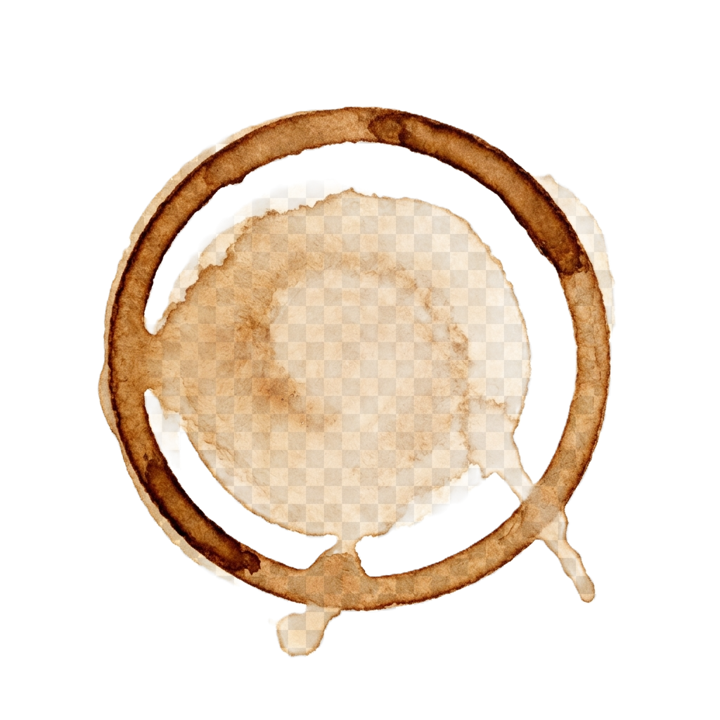
UNATTENDED
Running AI Orchestration Agents in Production
Randy Hinders
Director of IT, Mile Two
Startup Week Dayton 2026

Slide 2
Who Am I?
Director of IT at Mile Two — a Dayton-based tech company
I run a fleet of AI agents that handle real tasks — 24/7, without me watching
Email, social media, research, publishing — all automated
Writing a book about what I've learned: what works, what breaks, what nobody tells you
This isn't theory. This isn't a demo app. This is my production.

Slide 3
Who Am I?
Director of IT at Mile Two — a Dayton-based tech company
I run a fleet of AI agents that handle real tasks — 24/7, without me watching
Email, social media, research, publishing — all automated
Writing a book about what I've learned: what works, what breaks, what nobody tells you
This isn't theory. This isn't a demo app. This is my production.
DISCLAIMER

Slide 4
PART ONE
What is an AI Orchestration Agent?
And why it's not just "ChatGPT but fancier"

Slide 5
Chatbot vs. AOA
💬 Chatbot
REACTIVE
REACTIVE
You ask, it answers
One turn at a time
Limited memory between sessions
No access to your systems
Can't take action on its own
You're always driving

Slide 6
Chatbot vs. AOA
💬 Chatbot
🚀 AOA
REACTIVE
AUTONOMOUS
REACTIVE
You ask, it answers
One turn at a time
Limited memory between sessions
No access to your systems
Can't take action on its own
You're always driving
Tools — browser, email, calendar, code
Memory — remembers yesterday and last week
Triggers — acts on schedules and events
Multi-step — chains actions across systems
Orchestration — coordinates complex workflows
Runs while you sleep
vs

Slide 7
Chatbot vs. AOA
💬 Chatbot
🚀 AOA
REACTIVE
AUTONOMOUS
REACTIVE
You ask, it answers
One turn at a time
Limited memory between sessions
No access to your systems
Can't take action on its own
You're always driving
Tools — browser, email, calendar, code
Memory — remembers yesterday and last week
Triggers — acts on schedules and events
Multi-step — chains actions across systems
Orchestration — coordinates complex workflows
Runs while you sleep
vs
"ChatGPT is a smart intern waiting for instructions. An AOA is an employee with a laptop, credentials, and a to-do list who works the night shift."

Slide 8
The AOA Stack
🧠
LLM
The brain — Claude, GPT, etc. Reasoning and language.

Slide 9
The AOA Stack
🧠
LLM
The brain — Claude, GPT, etc. Reasoning and language.
🔧
Tools
Browser, email, calendar, file system, APIs, messaging.

Slide 10
The AOA Stack
🧠
LLM
The brain — Claude, GPT, etc. Reasoning and language.
🔧
Tools
Browser, email, calendar, file system, APIs, messaging.
💾
Memory
Persistent context — who you are, what happened, what's next.

Slide 11
The AOA Stack
🧠
LLM
The brain — Claude, GPT, etc. Reasoning and language.
🔧
Tools
Browser, email, calendar, file system, APIs, messaging.
💾
Memory
Persistent context — who you are, what happened, what's next.
⚡
Runtime
The orchestrator — triggers, routing, scheduling.

Slide 12
The AOA Stack
🧠
LLM
The brain — Claude, GPT, etc. Reasoning and language.
🔧
Tools
Browser, email, calendar, file system, APIs, messaging.
💾
Memory
Persistent context — who you are, what happened, what's next.
⚡
Runtime
The orchestrator — triggers, routing, scheduling.
📡
Channels
Discord, Slack, email, web — how the agent communicates.

Slide 13
PART TWO
Meet OpenClaw
The open-source runtime that turns a model into an AOA

Slide 14
What OpenClaw Is
Open-source agent runtime. Self-hosted. Mine runs on VM’s on my desk
Wraps any model — Claude, GPT, local — and gives it hands: tools, memory, schedules, channels
It IS the Runtime and Channels layers from the stack you just saw
The industry calls this layer a “harness.” I don’t like the term, so I call it an AOA
Meets you where you already are: Discord, Slack, Telegram, WhatsApp, Signal, email

Slide 15
How OpenClaw Works
⚙️
Gateway
One always-on process. Listens on every channel, owns the config, runs the clock

Slide 16
How OpenClaw Works
⚙️
Gateway
One always-on process. Listens on every channel, owns the config, runs the clock
🔔
Trigger
A message lands, a cron fires, or a heartbeat ticks

Slide 17
How OpenClaw Works
⚙️
Gateway
One always-on process. Listens on every channel, owns the config, runs the clock
🔔
Trigger
A message lands, a cron fires, or a heartbeat ticks
🤖
Session
The agent wakes with its identity, memory, and tools. "Thinks", acts, reports

Slide 18
How OpenClaw Works
⚙️
Gateway
One always-on process. Listens on every channel, owns the config, runs the clock
🔔
Trigger
A message lands, a cron fires, or a heartbeat ticks
🤖
Session
The agent wakes with its identity, memory, and tools. "Thinks", acts, reports
✅
Result
Replies in the channel, writes memory, goes back to sleep. Nobody is watching, its Unattended

Slide 19
An Agent Is a Folder
SOUL.md — who it is and how it talks
AGENTS.md — house rules, red lines, when to ask first
MEMORY.md + daily notes — what happened, what it learned
HEARTBEAT.md — the checklist it runs every 30 minutes on its own
Skills — packaged how-tos it can pick up
“Want a second agent? Copy the folder, change the soul.”

Slide 20
A Day in the Life
☀️
7:30 AM
Morning briefing posts to Discord before I’m up.
💼
8:30 AM
LinkedIn post goes out through the API.
💓
Every 30 min
VM health, cron status, token budget. Restarts Chrome itself if needed.
📈
4:35 PM
Trading run fires and reports the day.
🌙
3 AM Sunday
Housekeeping restart. I find out Monday.

Slide 21
PART THREE
From One Agent to a Team
One runtime. Many folders.

Slide 22
Use Cases
USE CASE 1
🤖 Personal Assistant
Checks email, monitors calendar, sends proactive updates, handles routine requests.
Your first AOA — one model, one channel, one job. Proof of concept.

Slide 23
Use Cases
USE CASE 1
USE CASE 2
🤖 Personal Assistant
📊 Specialist
Checks email, monitors calendar, sends proactive updates, handles routine requests.
Your first AOA — one model, one channel, one job. Proof of concept.
Give an AOA a specific role and expertise. Content publishing, market research, outreach automation.
Deep knowledge in one domain.

Slide 24
Use Cases
USE CASE 1
USE CASE 2
🤖 Personal Assistant
📊 Specialist
Checks email, monitors calendar, sends proactive updates, handles routine requests.
Your first AOA — one model, one channel, one job. Proof of concept.
Give an AOA a specific role and expertise. Content publishing, market research, outreach automation.
Deep knowledge in one domain.
"Your first agent is your proof of concept. Your second agent is where it gets interesting."

Slide 25
The Team
🤖
📈
🎨
📖
🔍
Tom
Cash
Oscar
Book-Tom
Scouts
Personal Assistant
Main operator
Trading Specialist
Market research
Content & Social
LinkedIn, publishing
Writing Assistant
Editing, research
Research Agents
On-demand tasks
"Each agent has a role, a personality, and a workspace. They communicate through shared channels.
It's not one AI doing everything — it's a team."

Slide 26
PART FOUR
Live Demo
The OpenClaw dashboard + a real-time publish

Slide 27
The Demo
📸
💬
🤖
🌐
💼
Take Photo
Send to
Discord
AOA
Picks It Up
Website
LinkedIn
→
→
→
→
Right here,
right now
From
my phone
Trigger
fires
randyhinders
.com
Thank-you
post
"One photo. Two platforms. Zero manual steps. That's orchestration."
📸 TAKE PHOTO AND SEND TO DISCORD

Slide 28
The Dashboard
Active sessions — who's running, what they're doing
Cron jobs — scheduled tasks that fire on their own
Connected channels — Discord, email, web
Memory & context — the agent's persistent knowledge base
Live terminal — watch the agent think in real time
⬆ SWITCH TO LIVE DASHBOARD

Slide 29
WHILE WE WAIT...
Questions?
The AOA is publishing right now — let's check it when it lands

Slide 30
Thank You!
🚀 Get Started Tonight
Create a new Google account
Install Antigravity
Use the $300 free GCP credit to make something!!

