Slide 1
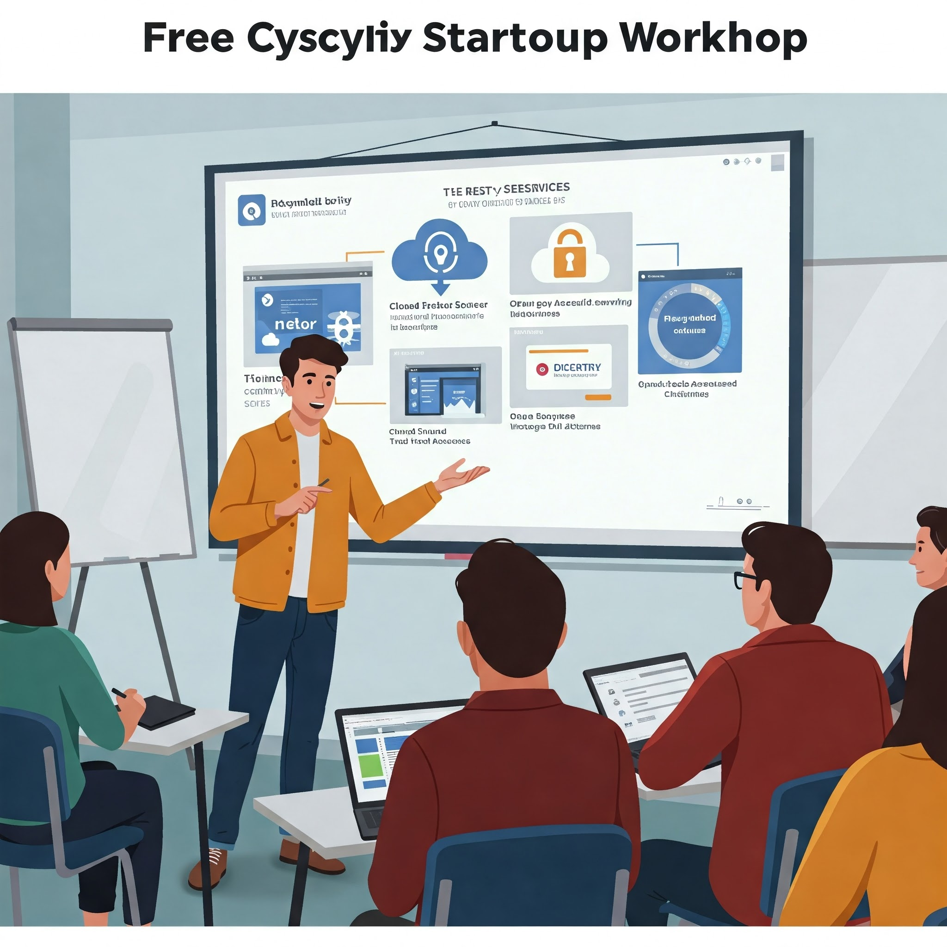
Cybersecurity 201 for Startups
Free and Open Source Tools to Protect Your Business
By Randy Hinders

Slide 2

Cybersecurity 201: Open-Source Tools
Cybersecurity 101 Recap
2024 Losses: $16.6 Billion
2023-2024 Increase: 33%
2024 Complaints: 859,532
Defense in Depth: Multiple Layers of Protection
Free/Open-Source Tools & working with your Managed Service Providers

Slide 3
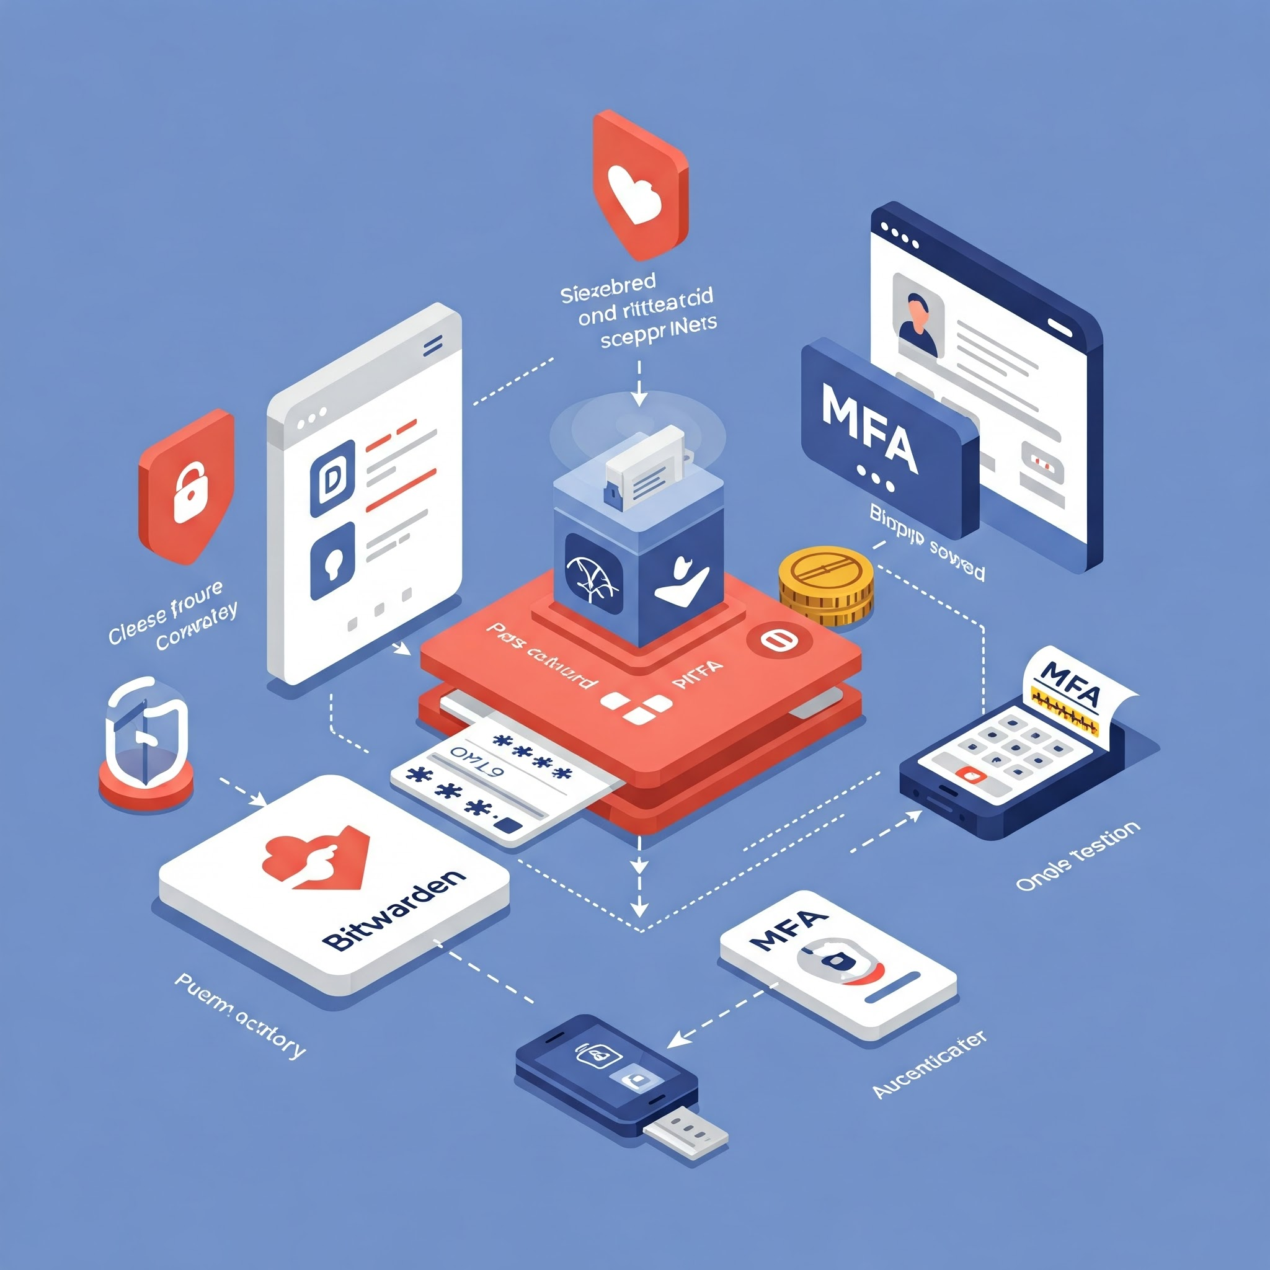
Password Management & MFA
Strong passphrase/biometrics
Multi-Factor Authentication (MFA) are essential
  Google Authenticator
  Microsoft Authenticator
  Authy
Password Managers:
  Bitwarden
  KeePass
  Chrome
  Phone/iOS & Samsung Pass

Slide 4
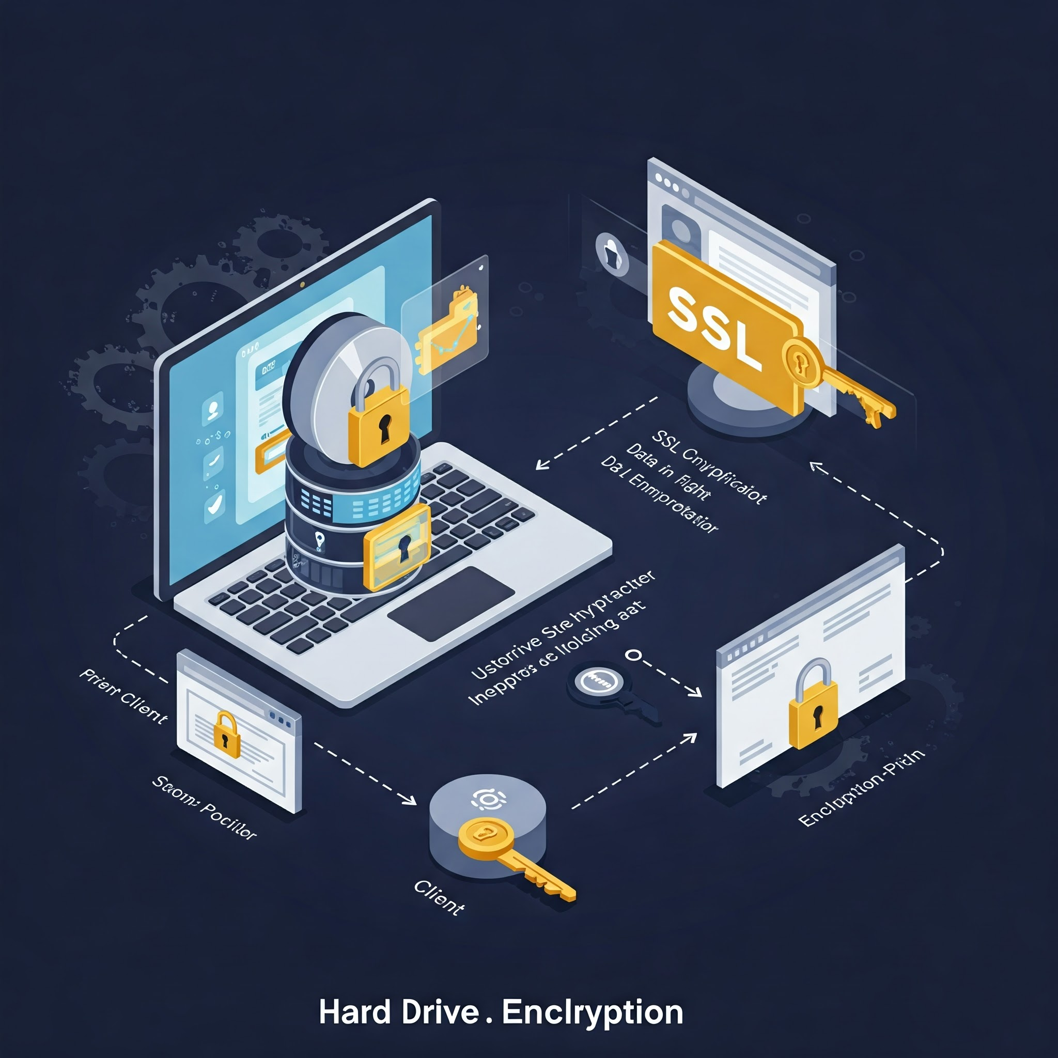
Data Protection
How do we protect data on devices and online?
Device Encryption for FREE:
  BitLocker (Windows): Built-in disk encryption
  FileVault (macOS): Built-in disk encryption
  Mobile Device Encryption: Enable and use strong passcode/biometrics
Website Encryption:
  Let's Encrypt: Free, automated, and open certificate authority

Slide 5
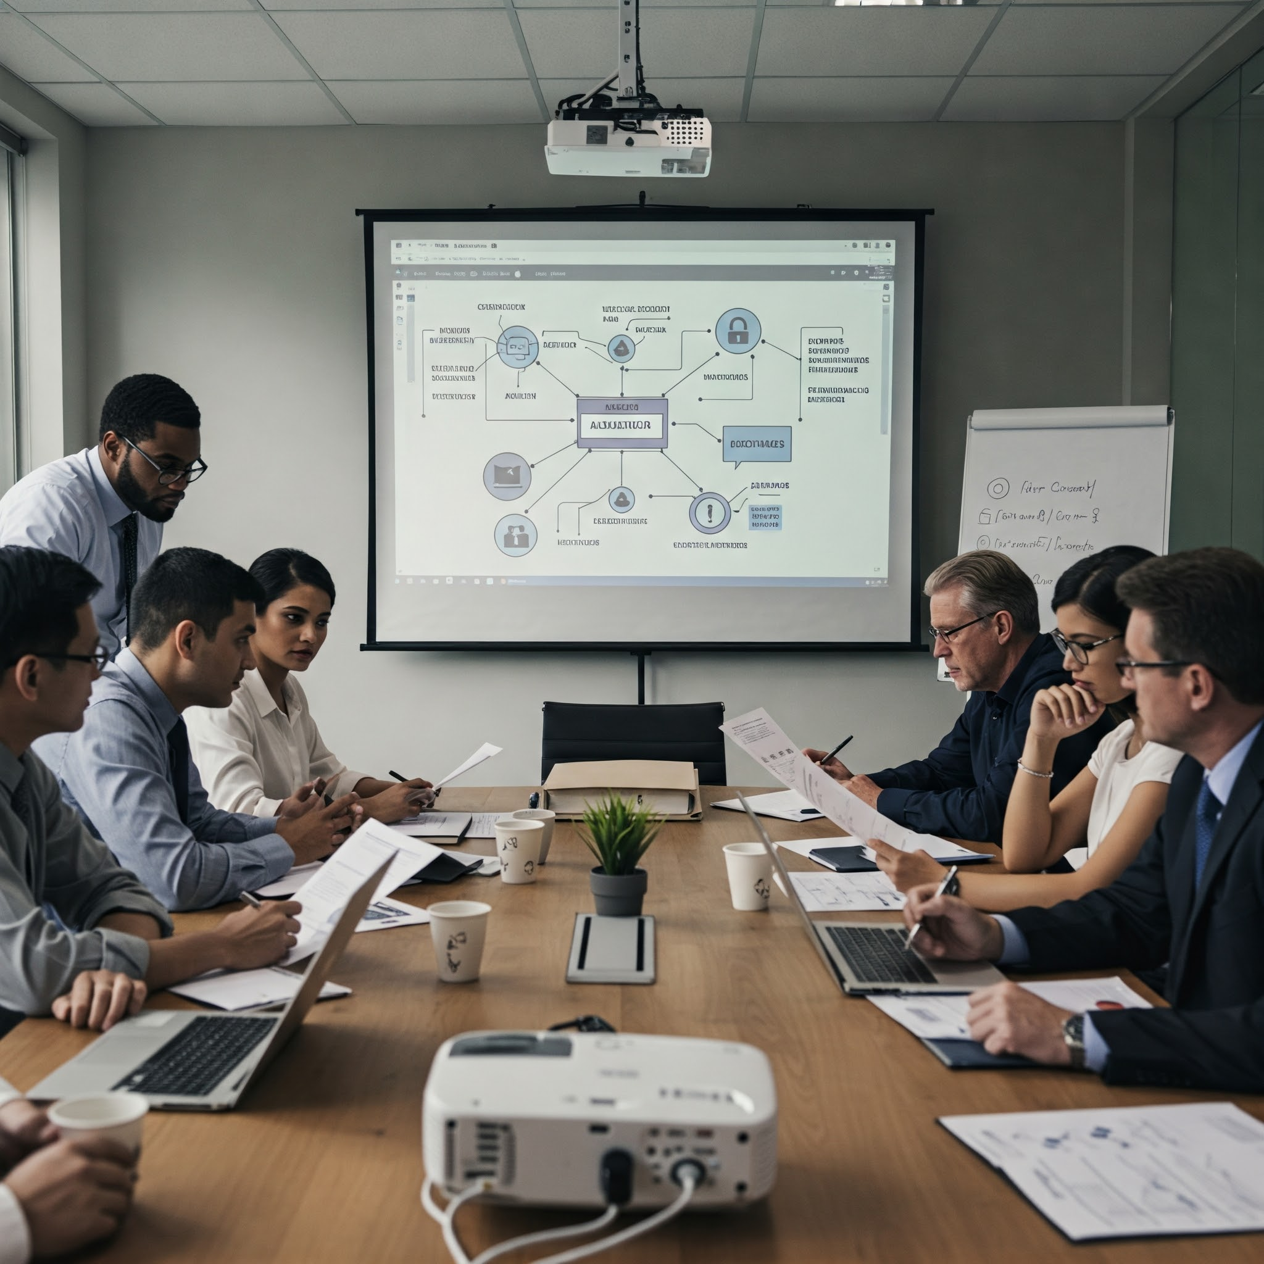
Network Security: Provider Expectations and Questions
MSP/ISP Responsibilities:
  Firewall Management: "Your MSP should provide and manage a robust firewall. Ask about their firewall policies and update procedures."
  Intrusion Detection/Prevention (IDS/IPS): "Inquire if your MSP offers IDS/IPS to detect and block malicious network activity."
  VPN Services: "If remote access is needed, your MSP should offer secure VPN solutions. Understand the VPN protocols they use."
  DNS Security: "Your ISP should provide secure DNS services to prevent DNS poisoning and other attacks. Ask about DNSSEC."
Questions to Ask:
  "What is your Service Level Agreement (SLA) for security incidents?"
  "Do you provide regular security audits or vulnerability scans?"
  "What security certifications do your staff hold?"
Cyber threats to critical infrastructure are a major concern. (Ask Huber Heights, Columbus, and other Ohio cities)

Slide 6
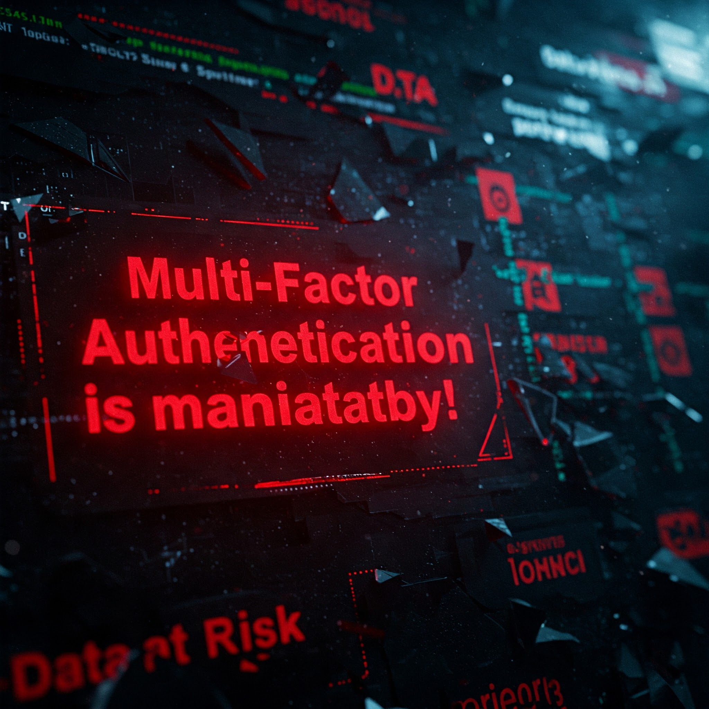
MFA is Mandatory
No Encryptions can save you if the bad actors have your password.
Bad actors with your password can login and bypass all security.
Multi-Factor Authentication is mandatory!
Use phishproof MFA like MS Authenticator App.
Without MFA, your data is at risk!

Slide 7
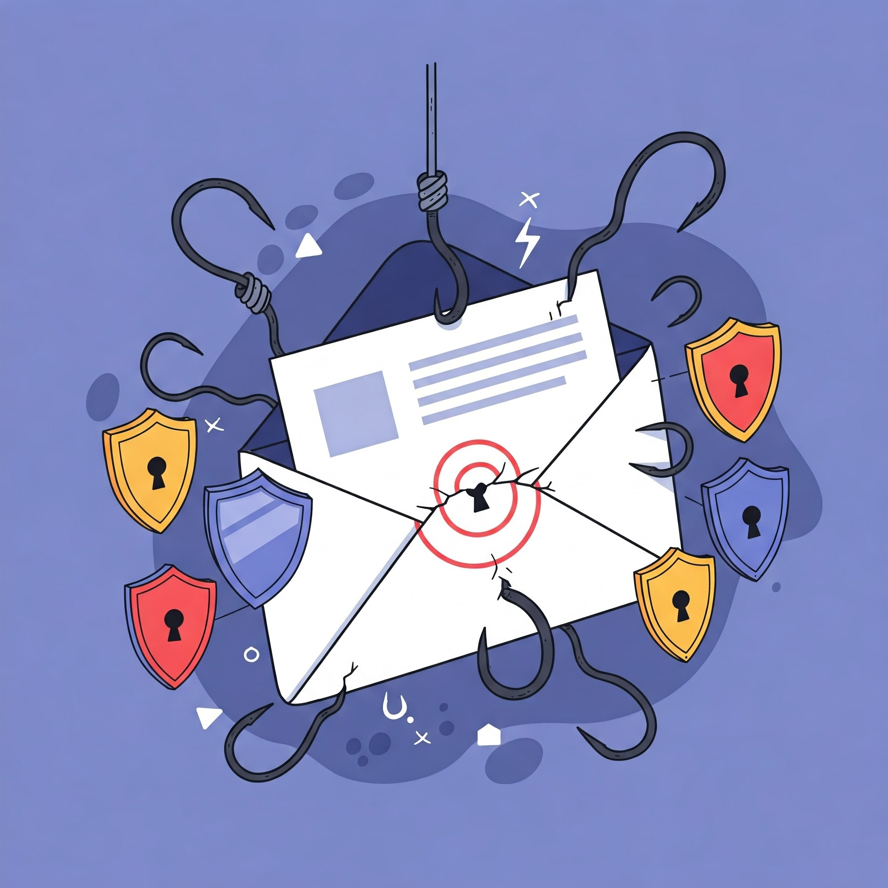
Email Security
Email is a primary attack vector for phishing and Business Email Compromise attacks.
SPF, DKIM, and DMARC are email security protocols that can help prevent spoofing.
Many email providers offer built-in or add-on email security features.
Thunderbird with Enigmail/GnuPG can encrypt individual emails but requires technical setup.
Business Email Compromise caused over $2.7 billion in losses.
Phishing/Spoofing is the most common complaint type.
DO NOT CLICK STUPID S#IT!!

Slide 8

Zero Trust Network Architecture (It’s not a product, it is a mindset!)
Zero Trust: Assume breach. Trust Nothing and Verify Everything.
  User (Is this really the user, MFA them)
  Session (how long since last re-login)
  Device (Is this a trusted device, new device)
  Location (Where are they coming from? China, NK)
  Role Based (Do they need to see this?)
Cloudflare for Zero Trust:
  Free tier for startups to implement Zero Trust principles.
  Secure remote access without a VPN, using identity-based authentication (Google, MSFT…)
  Useful for startups with legacy web-based systems.
Setup Managed Browser Profile & Context Aware Access (Google & M365)
WHY? Cyber-enabled fraud responsible for ~83% of all losses reported to IC3.

Slide 9

Let's Talk: Q&A
Thank You
Find me on LinkedIn @ www.linkedin.com/in/randyhinders/

