Slide 1
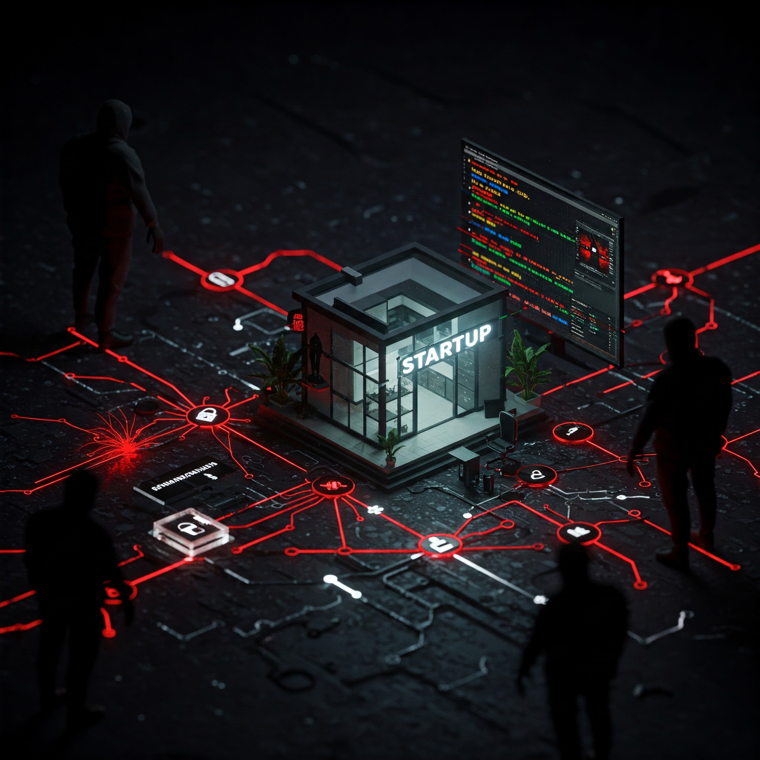
Cybersecurity 101 for Startups
By Randy Hinders

Slide 2
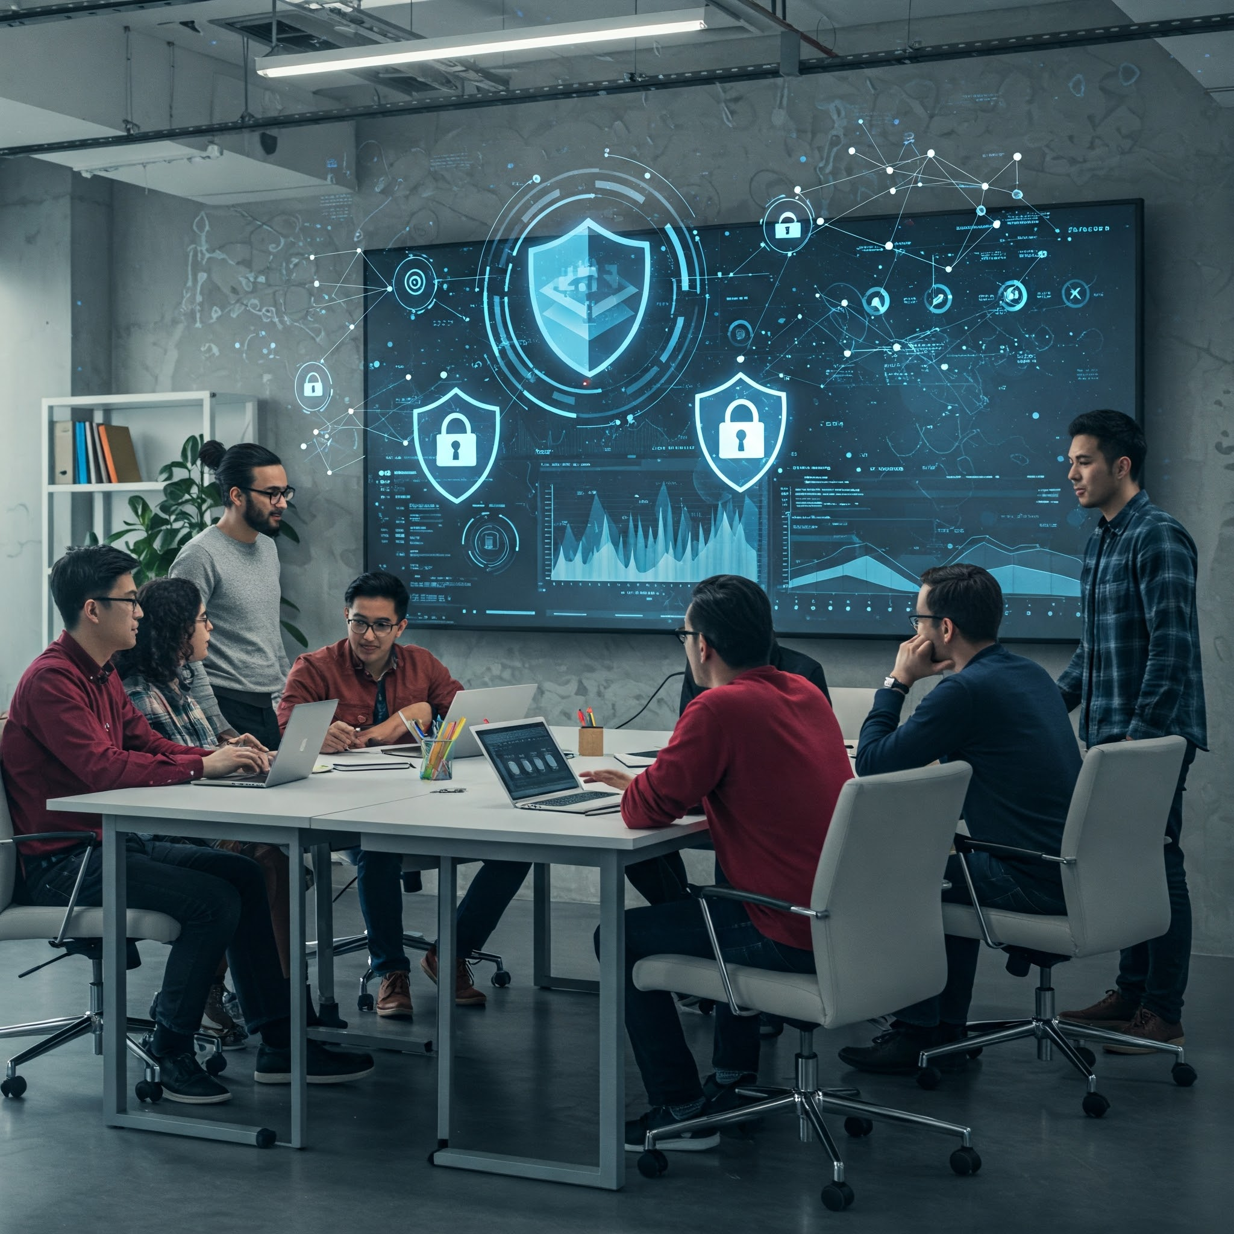
Why do you care?
Staggering IC3 reported losses in 2024: $16.6B, a 33% increase from 2023
Over 9 million complaints received by IC3 since founding, 859,532 in 2024 alone
Cyber threats are constantly evolving - startups must prioritize security from day one
Key topics: understanding cyber threats, proactive protection, impact, and practical steps

Slide 3
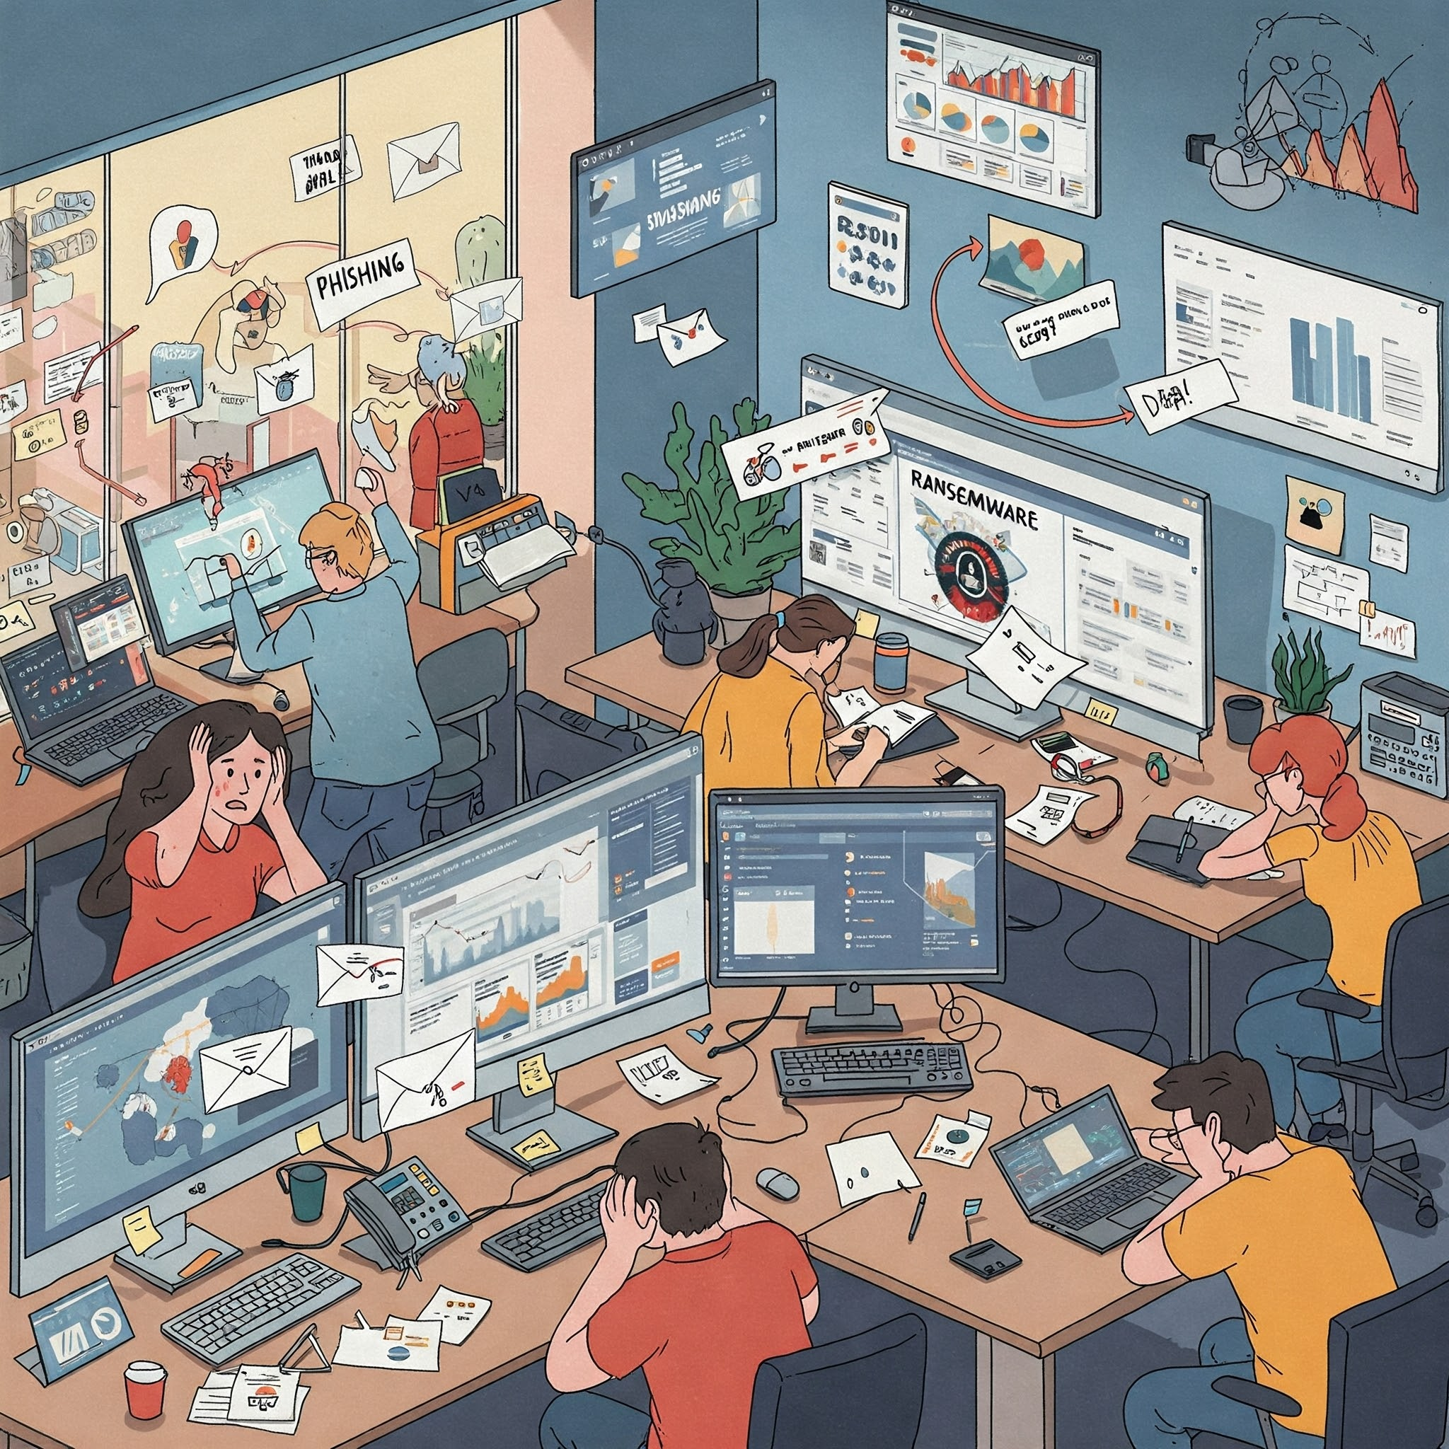
The Startup Threat Landscape
Common Threats: Phishing/Spoofing, Ransomware, Business Email Compromise, Data Breaches
Startups are Vulnerable: Limited Resources, Focus on Growth, False sense of security
Impact of Cyberattacks: Financial Loss, Reputational Damage, Legal Consequences
Average Loss Per Complaint: $19,372
BEC Losses: $2,770,151,146
Ransomware Complaints increased 9% from 2023

Slide 4
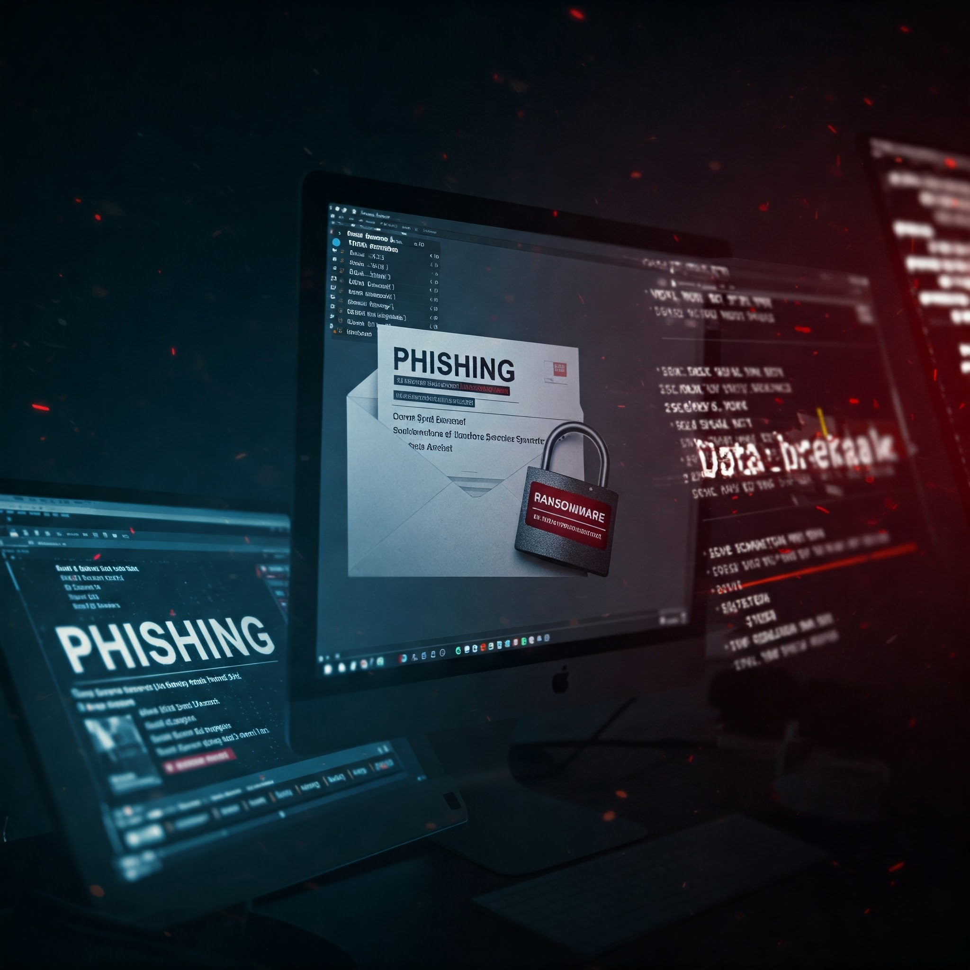
Common
Cyber
Threats
Phishing/Spoofing: Most common complaint, used to steal credentials and sensitive data.
Ransomware: Pervasive threat, 9% increase in 2024, targets critical infrastructure.
Data Breaches: Exposes sensitive data, causes financial and reputational damage.
Business Email Compromise (BEC): High financial losses for victim organizations.
Big or small, if you are on the internet you are a target for the bad actors from all over the world!

Slide 5

Startup Vulnerabilities
Limited Resources: Smaller budgets and no staff dedicated to security
Rapid Growth: Focus on growth will overshadow security concerns!
False Sense of Security: Startups mistakenly believe they are too small to be targets

Slide 6

Impact of Cyberattacks
Financial Loss: Avg. $19,372 per complaint - devastating for a startup.
Reputational Damage: Loss of customer trust, difficulty attracting investors.
Legal & Regulatory Consequences: Lawsuits, fines, compliance issues.
Avg. Loss Per Complaint: $19,372
Phishing/Spoofing Complaints: 193,407
Hacking as a service is a thing! The bad actors don’t care if they can get $3,000,000 or $3,000

Slide 7

Essential Cybersecurity Practices
Strong passwords & MFA: Prevent unauthorized access.
Data protection & encryption: Protects sensitive info.
Secure network configuration: Barrier against threats.
Employee training & awareness: Prevents phishing attacks.
Regular software updates: Addresses vulnerabilities.
Incident response planning: Minimize damage from attacks.

Slide 8
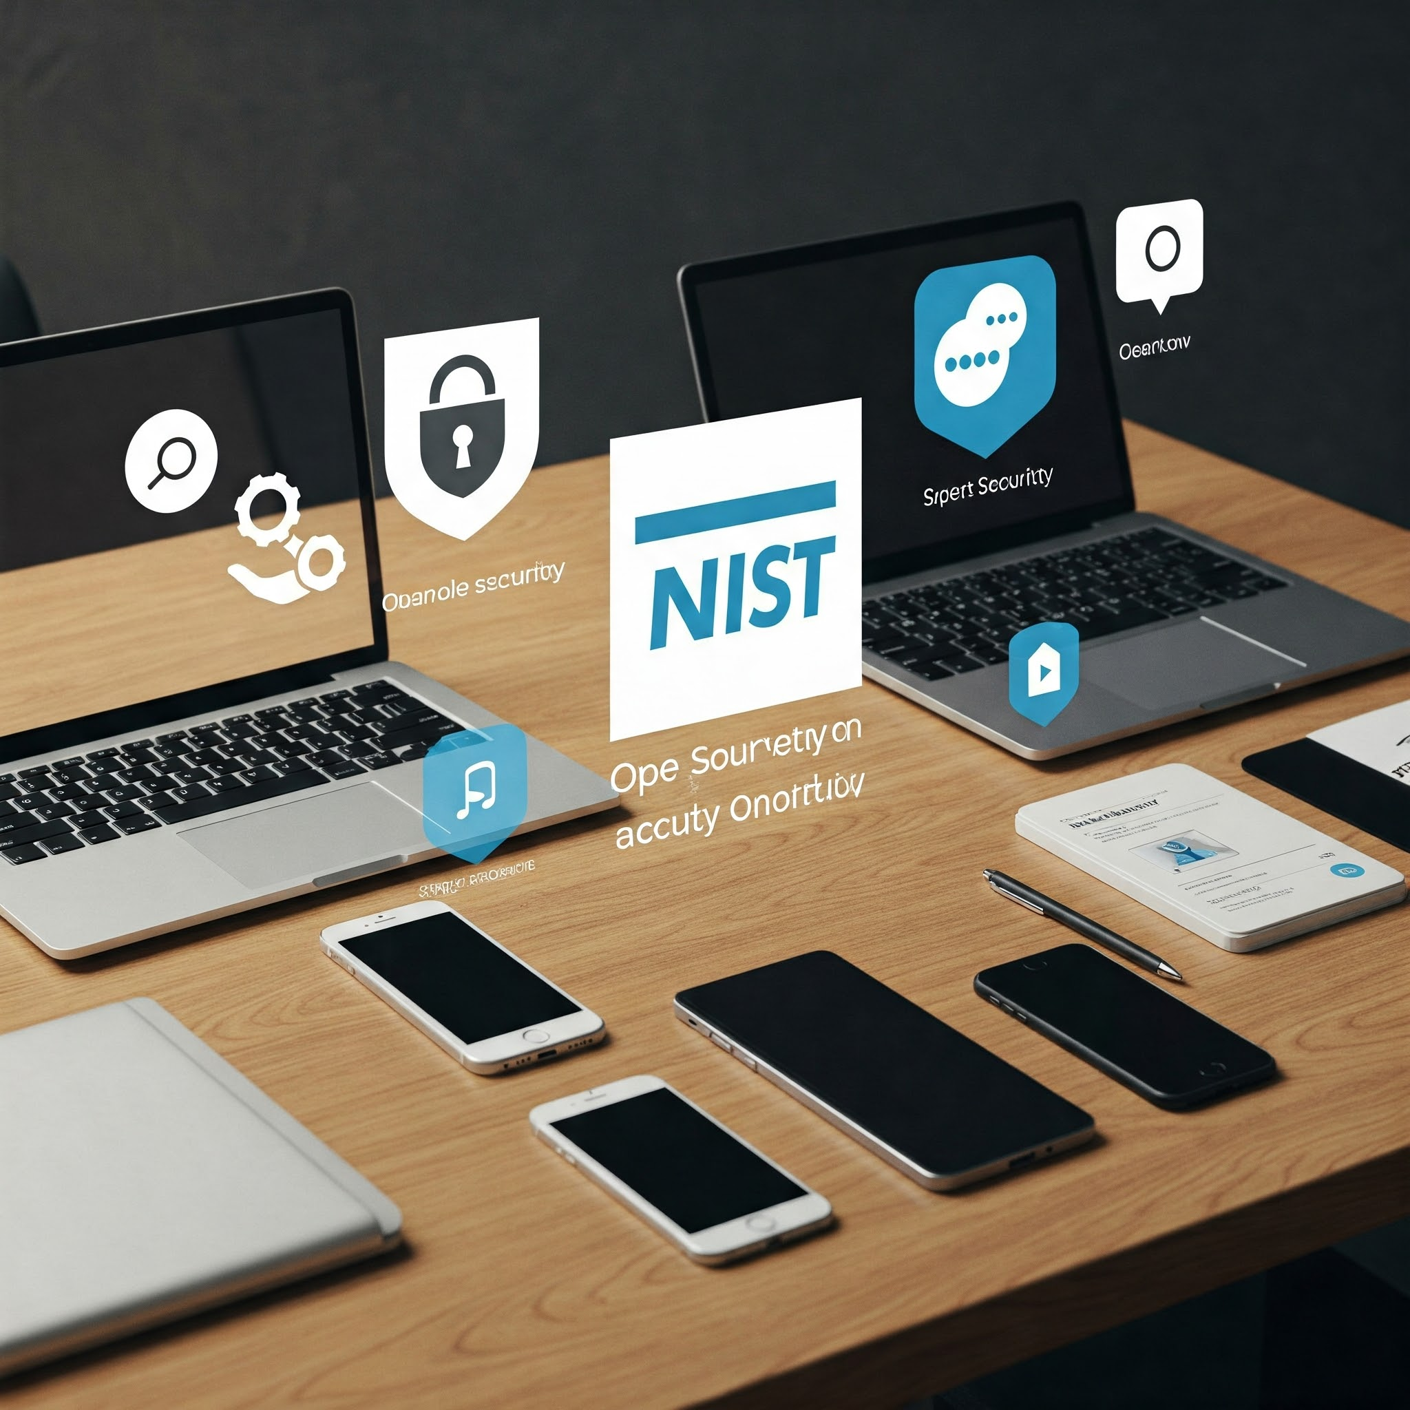
Affordable & Accessible Security
Free and low-cost security tools for startups
Open-source security solutions
NIST.GOV & cisecurity.org
SANS Institute
FBI IC3: Primary resource for reporting cybercrime and getting information on scams
Start Somewhere
Do Something

Slide 9
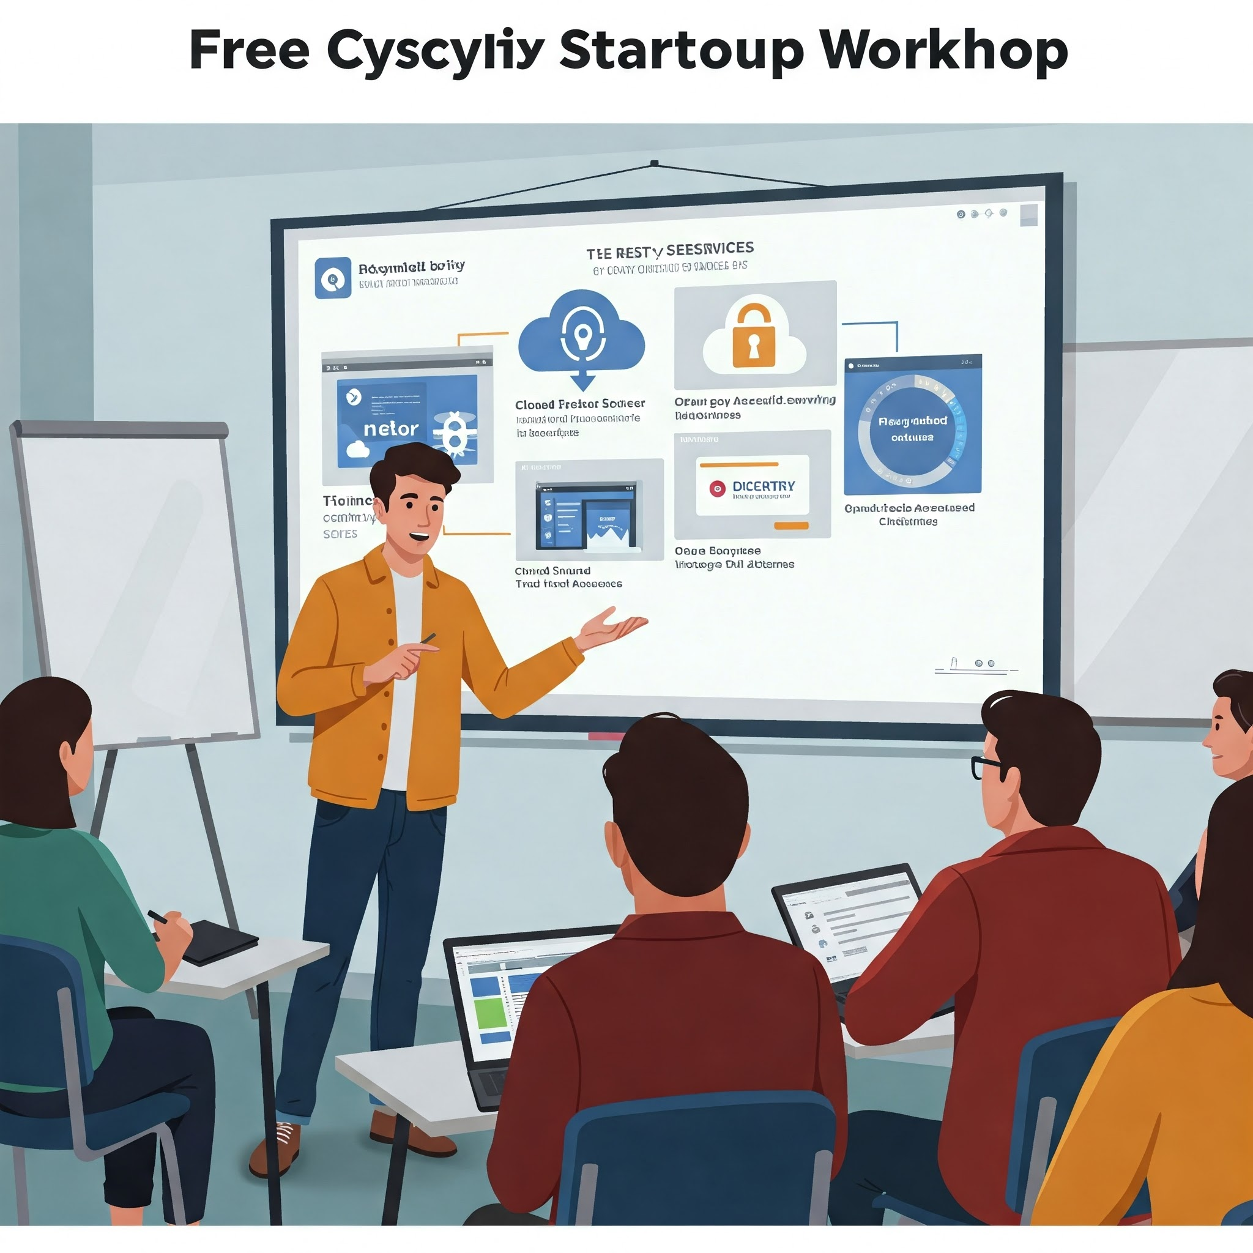
Cybersecurity 201 for Startups
Free and Open Source Tools to Protect Your Business
By Randy Hinders
Check agenda for this session!!

Slide 10

Let's Talk: Q&A
Thank You
Find me on LinkedIn @ www.linkedin.com/in/randyhinders/

